Slide 1
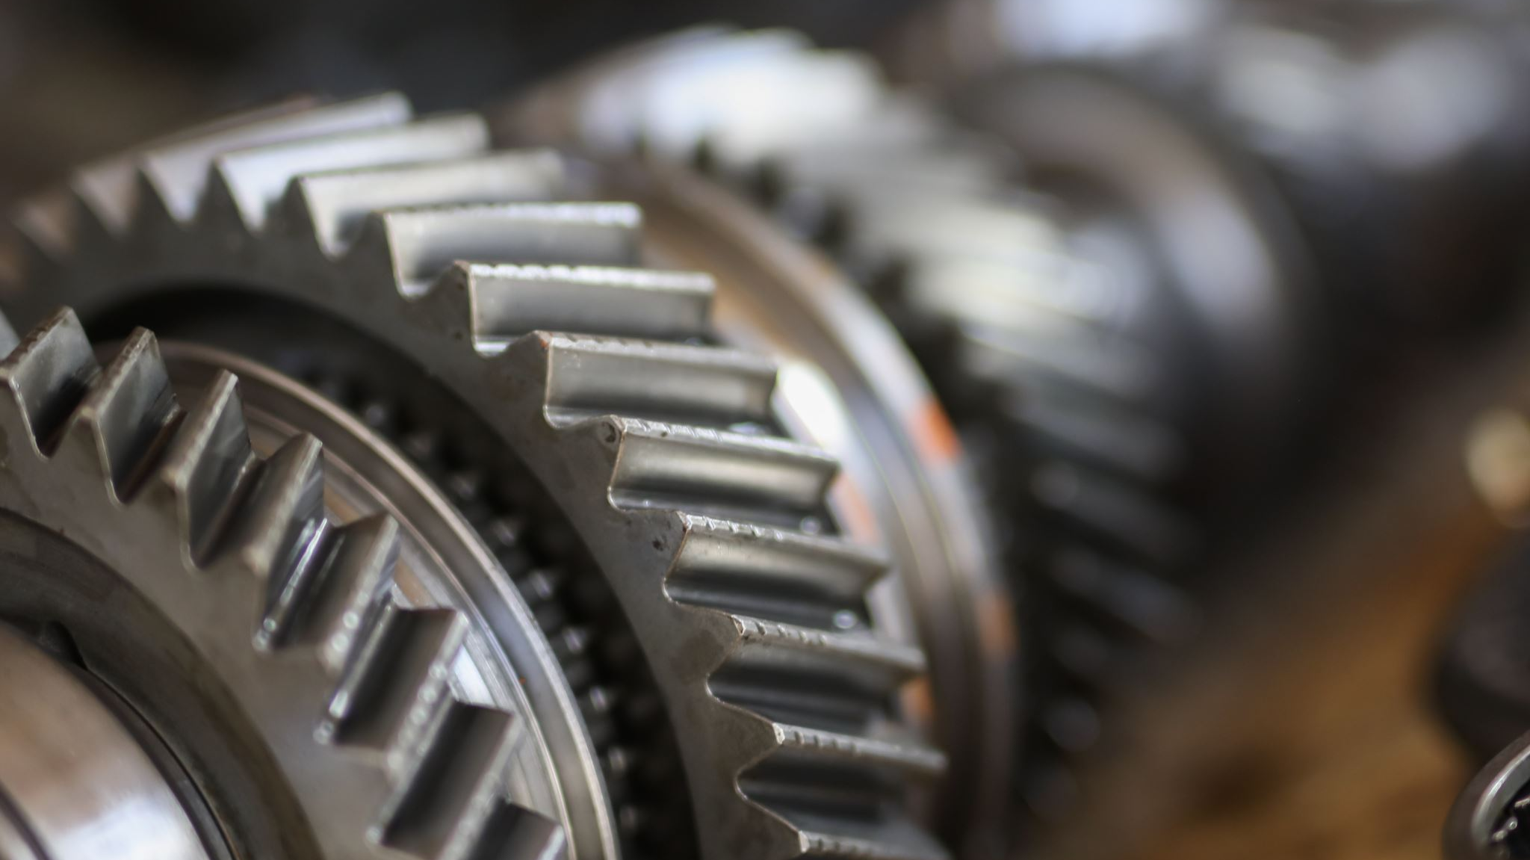
PREDICTIVE MAINTENANCE OF ENGINES
OUR TEAM:
SAKSHAM RATHI
PRIYANSHU PRASAD
PRIYANSHU BHATTACHARYA
CHANDRU S

Slide 2
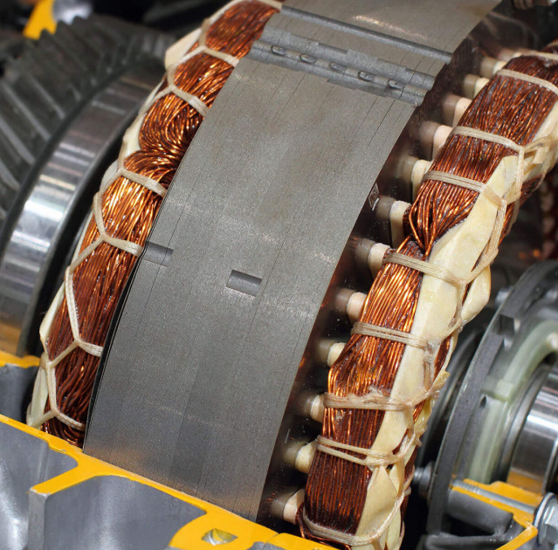
What is Predictive Maintenance?
Predictive maintenance is the practice of determining the condition of equipment in order to estimate when maintenance should be performed — preventing not only catastrophic failures but also unnecessary maintenance, thus saving time and money.

Slide 3
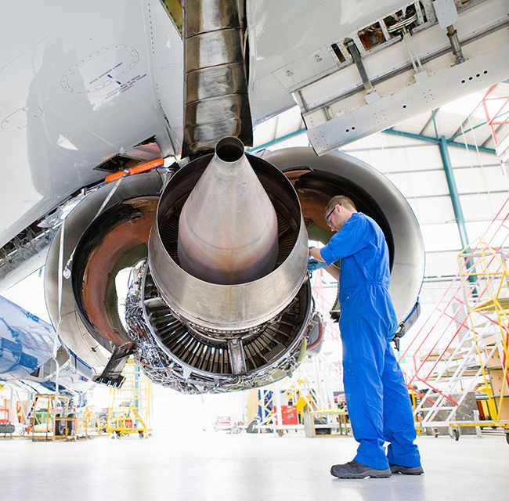
Our Problem Statement
Let's assume we are a manufacturer of aircraft gas turbine engines and we sell them. Our engines are really good, I would say the best on the market, but still, there could be failures from time to time. And failures and the following outage are very expensive for our customers, the operating companies. And if we maintain them too early without reason there is also an interruption that costs a lot of money. In short, maintaining an engine in time could save our customers a lot of money.

Slide 4
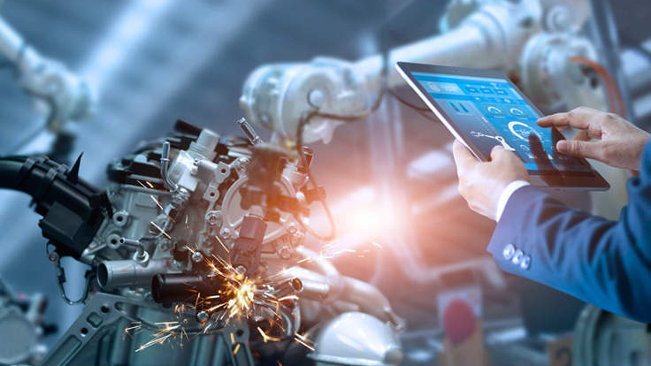
Our Solution
This predictive maintenance solution of ours focuses on the techniques used to predict when an in-service machine will fail, so that maintenance can be planned. The solution includes a usage of pre-configured machine learning algorithms, as well as custom python scripts(Notebooks), to enable an end-to-end solution from data processing to deploying of the machine learning model.

Slide 5
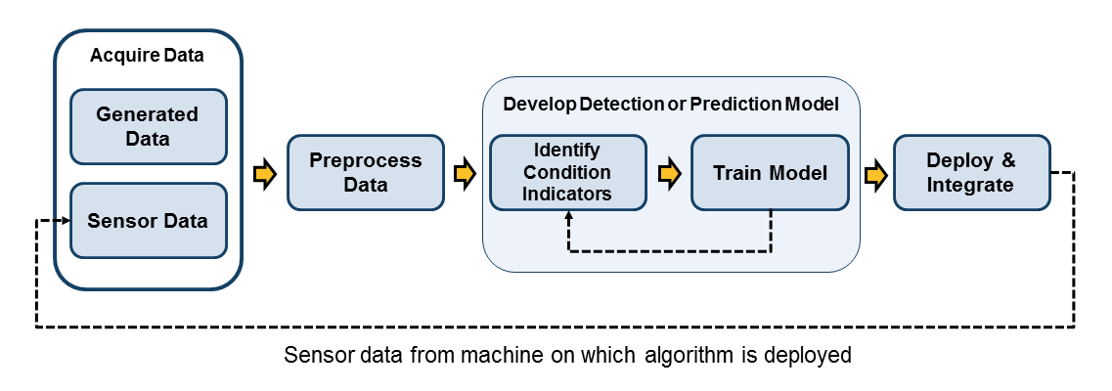
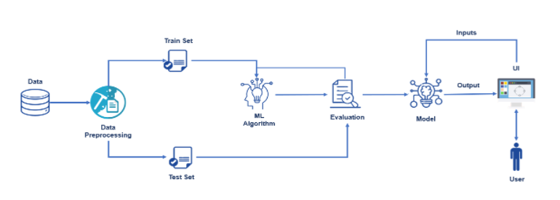
Our approach
Step 1: Data preparation and feature engineering.
Step 2: Train and evaluate model.
Step 3: Deploy as web service using IBM Cloud.

Slide 6

DEMONSTRATION

Slide 7
Applications of predictive maintenance
Automatives - In an industry that relies heavily on production and assembling, equipment failure can result in disruption and might incur the company millions. It is no surprise that the automotive industry will embrace PdM technology that reduces downtime and ensures continuous and efficient workflows.
Transportation - Airlines must consistently, closely monitor sensor data from the airplanes’ complex equipment. Proper functioning of equipment is of paramount importance to ensure passengers’ safety. Complex machinery present in trains can also benefit from predictive maintenance.
Ports - Since port equipment is continuously exposed to harsh conditions, their conditions deteriorate quickly. For example, cranes are crucial tools but are prone to failure. Crane downtime can lead to more waiting time for ships and lower throughput for ports. Reducing downtime can play a critical role in enhancing service quality and minimizing waste.

Slide 8
Benefits
Reduced downtime and longer life
Reduced maintenance costs
Improved safety

Slide 9
FUTURE ENHANCEMENTS
1. Reduce Overfitting
2. Use of LTSM and Neural Networks
3. A More User Friendly UI on the frontend

Slide 10
Thank you

